Slide 1
EC601:Photonics chips in machine learning on audio process
Sprint 3
Team 16: Taozhan Zhang

Slide 2
Basic Concept about Audio Processing
Audio processing, also called audio signal processing, is a type of signal processing electronic manipulation of audio signals, which are the electronic representations of sound waves. It include A/D convert, signal sampling, audio filtering, signal modulation, etc. In actual application, the digital audio signal processing is more popular as it allows greater control for the audio signal, especially when applying the machine learning techniques on it.

Slide 3
Application -- Active Noise Control
Active Noise Control: Also known as active noise cancellation, adding a converted phase audio wave to offset unwanted noise. To gather the noise, additional microphone is necessary to integrate in the equipment and convert the analog signal to digital signal via a processing unit then generate the converting sound and returning to the channel of speakers.

Slide 4
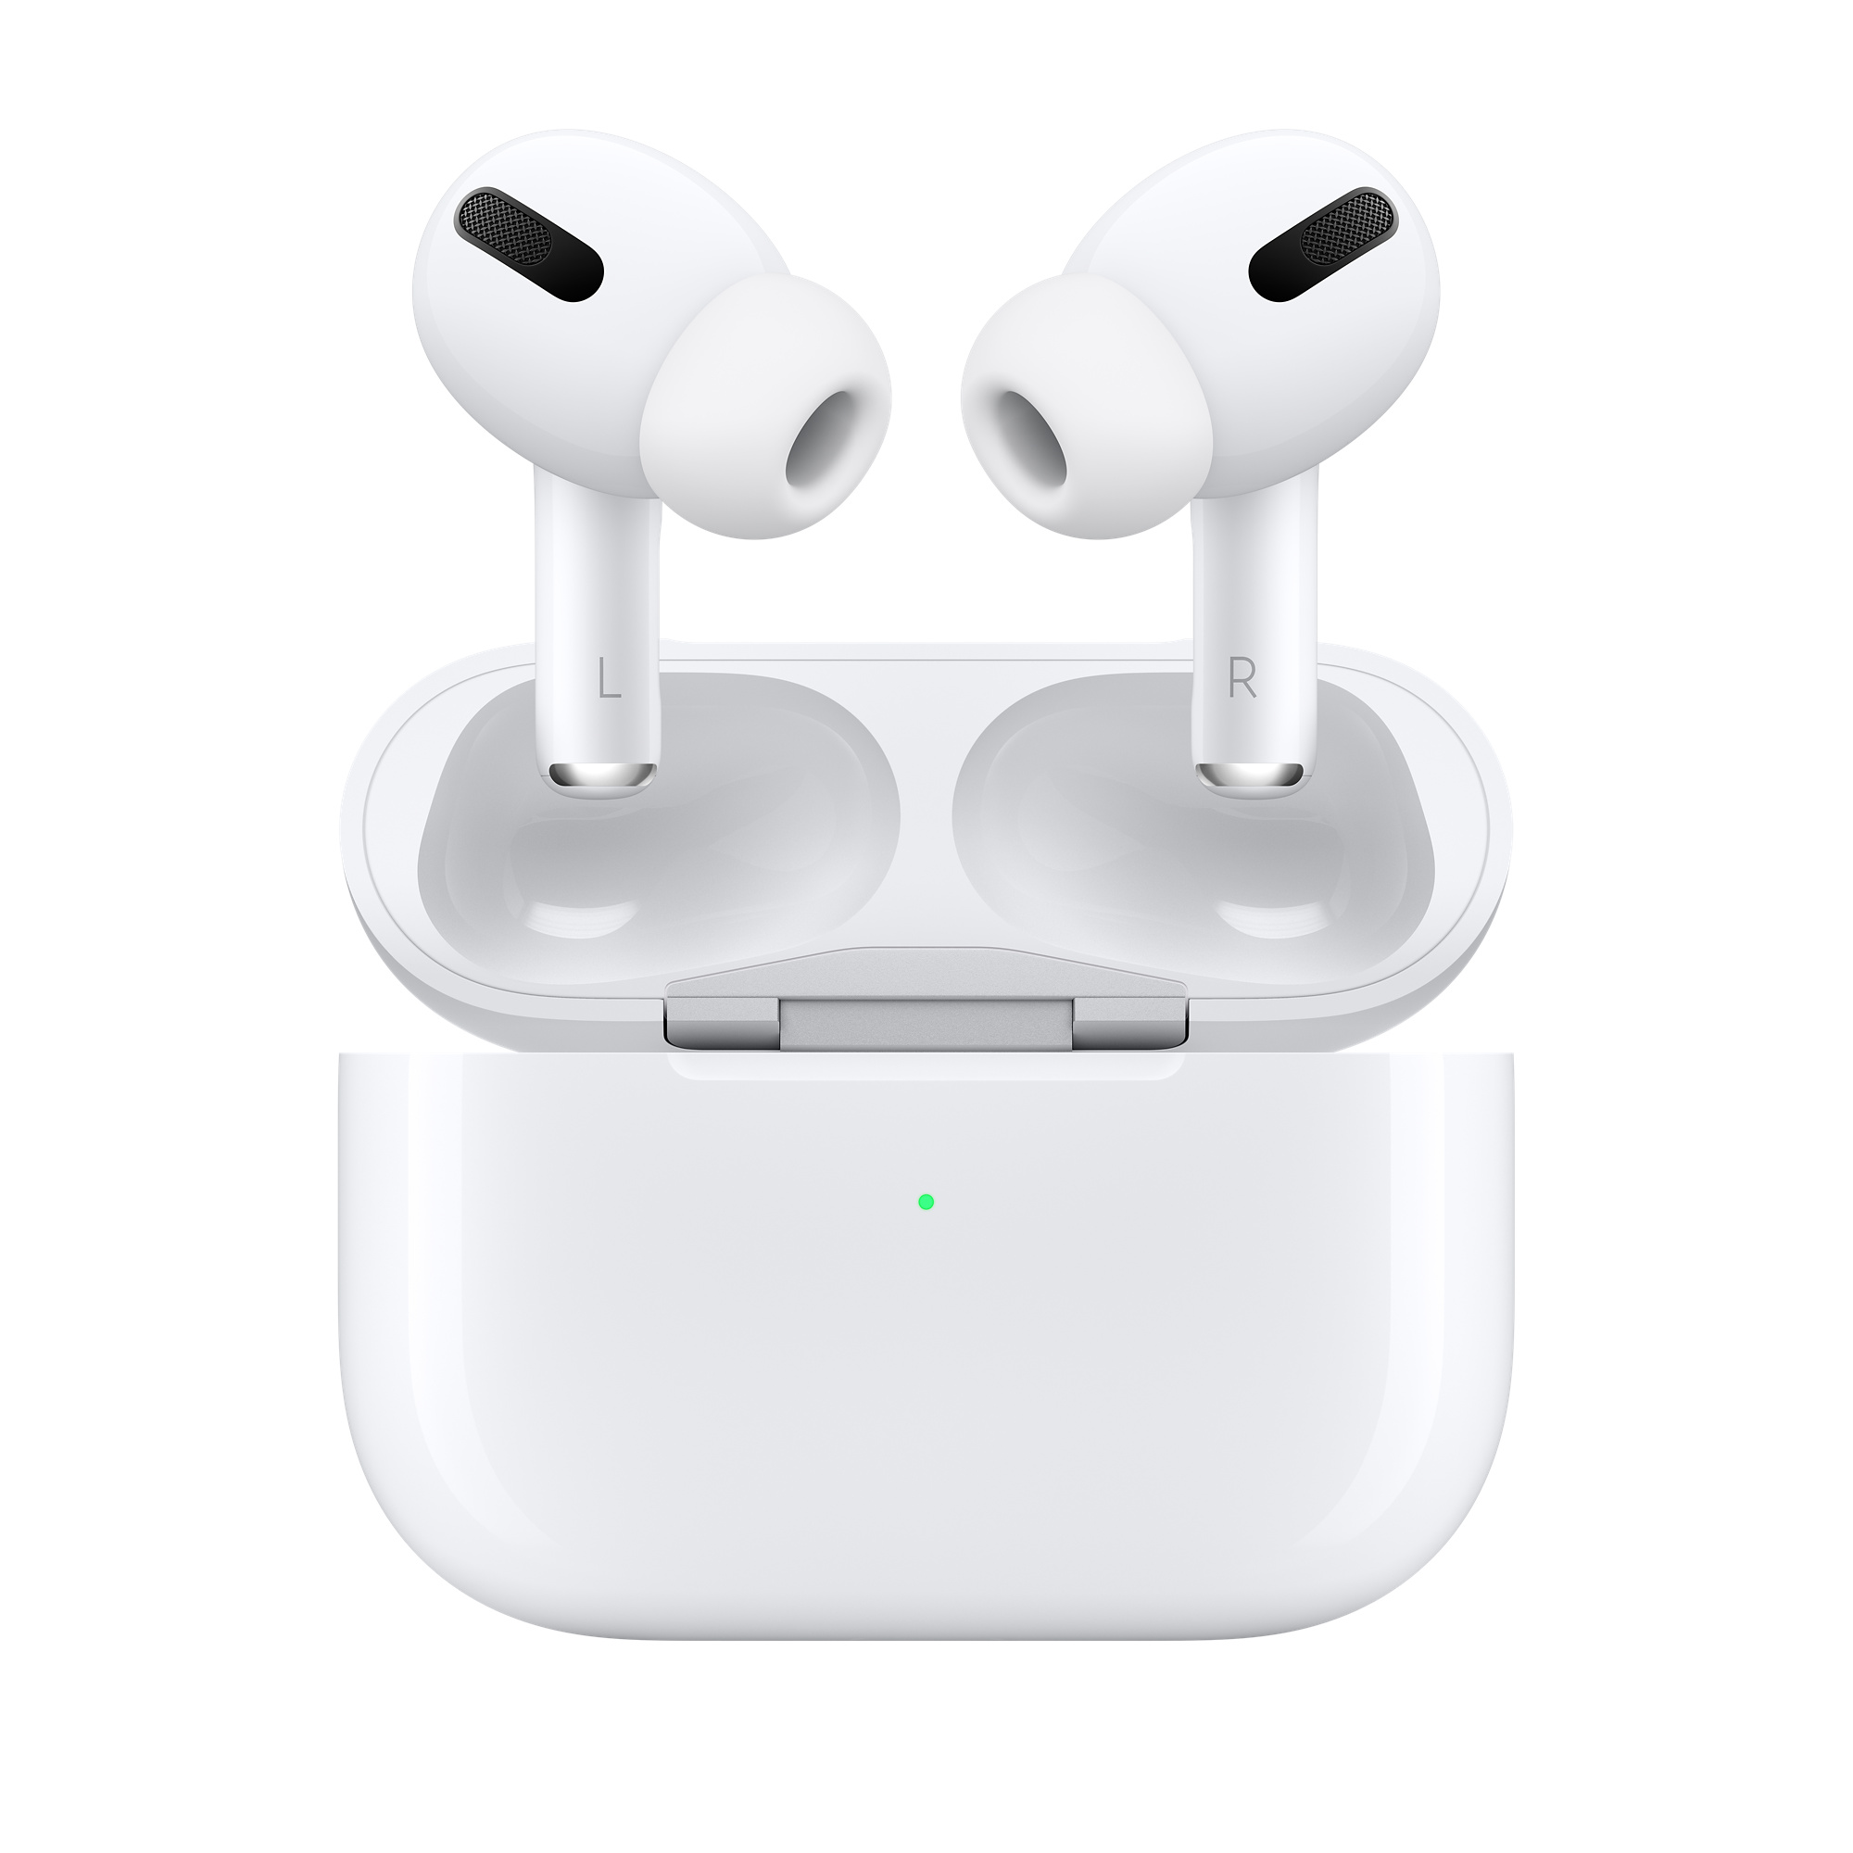
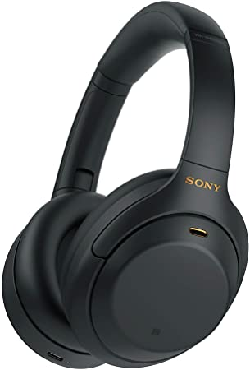
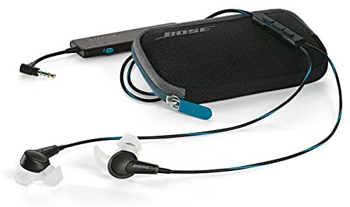
Examples of Application Products

Slide 5
Plan for Sprint 4
Using some c++/python libraries to program the appropriate and working example code and test it under some specific scenarios
Researching on the exist applications and embedded features on some products to know how it grade the noise level in the surroundings and handle the noise accordingly(sony headphones connect, i.e.)
Researching on the possible further application relative to the photonic chips
Learning more details about how the machine learning is applied in the audio process

Slide 6
Reference
https://en.wikipedia.org/wiki/Audio_signal_processing
https://en.wikipedia.org/wiki/Active_noise_control
https://www.wise-geek.com/what-is-audio-processing.htm
https://towardsdatascience.com/how-to-apply-machine-learning-and-deep-learning-methods-to-audio-analysis-615e286fcbbc
https://processing.org/reference/libraries/sound/index.html
https://electronics.sony.com/headphones-connect-app
https://krisp.ai/?gclid=CjwKCAiA7dKMBhBCEiwAO_crFMCISCBQYvb5mi-WUqQpXMDit-l0Du1uvNfBL6CClO5aEWohNa2uqxoC4J0QAvD_BwE
https://www.dspguide.com/ch22/7.htm

Slide 7
Thank you!

